Slide 1
Reasoning vs Reciting in LMs

Slide 2
Reasoning vs Reciting in LMs
Precog Reading Task
Ampili Karthikeyan
DEC
2025

Slide 3
Abstract
This is a fascinating study on how AI "thinks." It basically asks: Is the AI actually solving the logic of a problem, or is it just remembering the answer from a similar problem it saw before?
The Big Question
Do Large Language Models (LLMs) have general reasoning skills they can use anywhere, or are they just really good at repeating specific patterns they learned during training?
The Experiment: The "Counterfactual" Test
To find out, researchers tested AI on 11 different tasks but added a twist. They created Counterfactual Variants—problems where the "default rules" were changed.
Standard Task: "Solve this math problem using standard Base-10 numbers..
Counterfactual Task: "Solve this same math problem, but imagine we are using Base-9 numbers." (A rule change that requires actual reasoning).
AI models are like students who are great at passing practice exams but struggle when the teacher asks a "trick question" that requires applying the same logic in a new way. They have some abstract skills, but they aren't fully "universal" thinkers yet.

Slide 4
Major Strengths of the Counterfactual Framework
Counterfactual evaluation reveals whether LMs truly generalize tasks.
CCC ensures failures are not due to misunderstanding prompts. Approach highlights overfitting to default worlds vs. genuine task ability.
Provides a richer framework for assessing LM generalization.
Task level Generalizability
Novel Evaluation Paradigm
Counterfactual Comprehension Check (CCC)
Comprehensive Task Suite

Slide 5
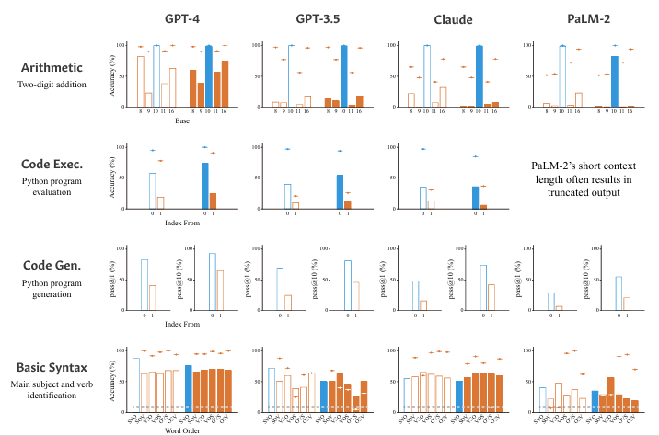
Key Findings:Consistent Performance Degradation

Slide 6
Zero-shot Chain-of-Thought (Zero-shot CoT) is a prompting technique used to make AI models "think" more logically without giving them any specific examples of how to solve a problem.
It is best known for the simple, "magic" phrase: "Let's think step by step."
Zero-shot: You provide zero examples or demonstrations in your prompt. You just ask the question directly.
Chain-of-Thought: You encourage the model to break the problem into small, logical intermediate steps before giving the final answer.

Slide 7
Factors Influencing Counterfactual Performance
Researchers evaluated GPT‑4, GPT‑3.5, Claude, and PaLM‑2 with and without zero‑shot chain‑of‑thought prompting .
Across tasks, models performed much worse on counterfactual variants than on default setups.
High CCC accuracy (especially for GPT‑4) revealed large performance gaps between default and counterfactual conditions, showing limits in abstract reasoning and suggesting tasks‑specific overfitting.
In cases of low CCC accuracy, failures in counterfactual comprehension further highlight that many abilities do not transfer beyond default conditions.

Slide 8
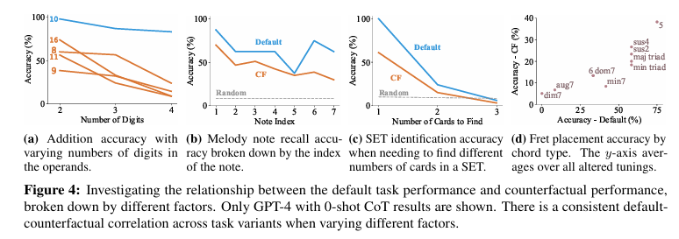
Weaknesses and Limitations of the Study
LMs perform best on common and familiar counterfactuals, show strong correlation between default and counterfactual performance, but prompting alone cannot overcome the limitations of memorization and non‑transferability.

Slide 9
This passage explores a simple question: If an AI is good at a normal task, will it also be good at that same task when the rules are flipped or changed (a "counterfactual" version)? Researchers wanted to see if an AI's performance in the "real world" (default) matches its performance in a "make-believe world" (counterfactual) where the logic is slightly different. They tested this by changing three things: the difficulty of the task, the specific examples used, and the AI model itself.
1. Harder Tasks Show the Same Pattern
The researchers tested different levels of difficulty to see if the correlation held up:
Math: They moved from simple 2-digit addition to 3-digit and 4-digit addition.
Music: They asked the AI to find notes in a melody, making it harder by asking for notes further along in the sequence.
Logic Games (SET): They made the game harder by showing fewer cards to the AI. The Result: Even as tasks got harder, if the AI was good at the "normal" version, it stayed relatively good at the "counterfactual" version.
2. Specific Examples and Model Strength
Specific Examples: They looked at individual problems (like different types of musical chords). They found that if an AI struggled with a specific "normal" chord, it also struggled with that same chord in a counterfactual setting.
Model Power: Generally, "smarter" AI models (like GPT-4) performed better in both the normal and make-believe worlds compared to "weaker" models.

Slide 10
Generalizability of Counterfactual Techniques
Human performance in counterfactuals
Task-specific vs. general reasoning
Value of counterfactual tasks

Slide 11
Conclusion: Implications for LM Development
The study found a strong correlation across the board. This means that an AI’s ability to solve a standard problem is a very reliable predictor of how well it can handle a modified, counterfactual version of that same problem. Therefore, we shouldn't dismiss an AI's "normal" performance—it proves the model has a genuine underlying skill that works even when the rules change.
We found that AI struggles when we change the 'default' rules of a task. This happens because the AI is just repeating patterns it has read earlier, rather than learning the actual logic. In the future, we need to see if teaching AI about the 'real world' helps it to become more flexible

Slide 12

Future Directions in Language Model Research
Interdisciplinary Approaches: Integrating insights
from cognitive science, linguistics and computer science
can enhance our understanding of language processing in
models.
Ethical Considerations : As language models become more
advanced, addressing ethical considerations such as bias and
misinformation is crucial.
Adaptive Learning Mechanisms : Implementing adaptive
learning strategies that allows models to adjust their feedback
based on feedback and context an significantly improve
performance in dynamic environments.

Slide 13



